Slide 1
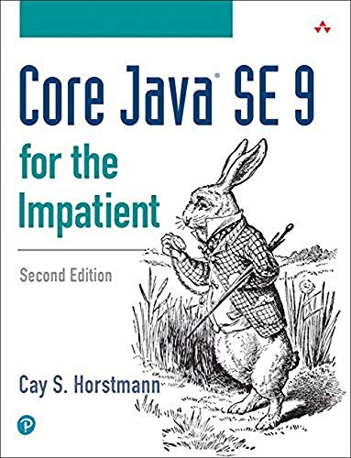
Object-Oriented Programming and Data Abstraction Lesson 10: Streaming Using Lambdas
Chapter 8
Notes:
Replace this with your course title and your name/contact details.

Slide 2
Functional Interfaces and their Functional Methods (a review)

Slide 3
Reminder: Functional Interfaces
A functional interface is an interface that defines only one method.
Comparable – defines compareTo()
Comparator – defines compare()
Java provides us with some very useful functional interfaces:
Predicate, BiPredicate, Function, BiFunction, Consumer, BiConsumer
These are often expected as parameters
You can assign a lambda expression to a functional interface or you could use a method reference.
Class::instanceMethod
Class::staticMethod
object::instanceMethod
Class::new (to reference constructor)
Some Examples
String::compareToIgnoreCase
Person::getDateOfBirth
joe::getSalary
Person::new

Slide 4
Functional Interfaces and their Methods
Some important functional interfaces
Interface | Description | Functional Method
Runnable | Represents an operation that accepts no input arguments and returns no result. | Functional method: run void run()
Supplier<T> | Represents an operation that accepts no input arguments and returns an object of type T. | Functional method: get T get()
Consumer<T> | Represents an operation that accepts a single input argument and returns no result. | Functional method: accept void accept(T t)
BiConsumer<T,U> | Represents an operation that accepts two input arguments and returns no result. | Functional method: accept void accept(T t, U u)
Function<T,R> | Represents a function that accepts one argument and produces a result. | Functional method: apply R apply(T t)
BiFunction<T,U,R> | Represents a function that accepts two arguments and produces a result. | Functional method: apply R apply(T t, U u)
Predicate<T> | Represents a predicate (boolean-valued function) of one argument. | Functional method: test boolean test(T t)
BiPredicate<T,U> | Represents a predicate (boolean-valued function) of two arguments. | Functional method: test boolean test(T t, U u)

Slide 5
From iteration to streams

Slide 6
Streams and Collections
A collection is an in-memory data structure to hold values and before we start using collection, all the values should have been populated.
Whereas a stream is a data structure that is computed on-demand.
Streams do not store data, they operate on the source data structure and produce pipelined data that we can use and perform specific operations such as filtering
Streams are consumable. It is impossible to reuse the same stream multiple times.
Streams support sequential as well as parallel processing, parallel processing can be very helpful in achieving high performance for large collections.

Slide 7
From iteration to streams
private static long longWordsIterate(List<String> words) {
int count = 0;
for (String w : words) {
if (w.length() > 12) count++;
}
return count;
}
private static long longWordsStream(List<String> words) {
return words.stream()
.filter(w -> w.length() > 12)
.count();
}
Code is more intuitive, each operation on the stream is clearly described.
Where the loop prescribes the order of operations in complete detail, a stream is able to schedule the operations any way it wants. We could even process in parallel!

Slide 8

How stream coding works
Step 1
Create a stream.
Specify intermediate operations for transforming the initial stream into others, possibly in multiple steps.
Apply a terminal operation to produce a result. This operation forces the execution of the lazy operations that precede it. Afterwards, the stream can no longer be used.
In step 2, the number of obects and the type of objects in the stream can change many times
Step 3

Slide 9
How to create a stream
Collections can produce streams via the stream methods below
default Stream<E> | stream() Returns a sequential Stream with this collection as its source.
default Stream<E> | parallelStream() Returns a possibly parallel Stream with this collection as its source. When a stream executes in parallel, the Java runtime partitions the stream into multiple substreams. Aggregate operations iterate over and process these substreams in parallel and then combine the results.
private static double averageSalaryByGender(
Set<Person> persons, Person.Gender gender) {
return persons.parallelStream()
.filter(p -> p.getGender() == gender)
.mapToDouble(Person::getSalary)
.average()
.getAsDouble();
}
Will be explained later in this deck

Slide 10
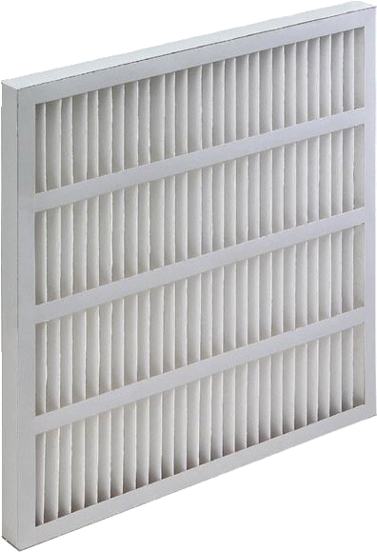
What can you do with Streams? Here are some methods of the Stream class
Long | count() Returns the count of elements in this stream.
Void | forEach(Consumer<? super T> action) Performs an action for each element of this stream.
Stream<T> | filter(Predicate<? super T> predicate) Returns a stream consisting of the elements of this stream that match the given predicate.
Strings
filter
private static long longWordsStream(List<String> words) {
return words.stream()
.filter(w -> w.length() > 12)
.count();
}
private void displayLongWords(List<String> words) {
words.stream()
.filter(w -> w.length() > 12)
.forEach(w -> System.out.println(w));
}
Strings longer than 12

Slide 11
Collecting elements of a stream

Slide 12
Collecting the results of a stream
<R,A> R | collect(Collector<? super T,A,R> collector) Performs a mutable reduction operation on the elements of this stream using a Collector. A mutable reduction operation accumulates input elements into a mutable result container, such as a Collection, as it processes the elements in the stream.
Object[] | toArray() Returns an array containing the elements of this stream.
List<Integer> luckyNumbers = Arrays.asList(7, 10, 11, 13, 19, 30, 41);
List<Integer> oddLuckyNums = luckyNumbers.stream()
.filter(i -> i % 2 != 0)
.collect(Collectors.toList());
Tell the JVM to process the List of integers serially (not in parallel).
Filter by restricting values to odd numbers.
Collect the resulting numbers from the odd number stream to a new ArrayList. (toList() creates an ArrayList)
.collect(Collectors.toCollection(LinkedList::new));
This alternate code collects the resulting numbers from the odd number stream to a new LinkedList.

Slide 13
Very powerful to build Maps using Grouping
public static ArrayList<Book> books = new ArrayList<Book>();
public static void main(String[] args) {
addBooks();
Map<Genre, List<Book>> booksByGenre =
books.stream().collect(Collectors.groupingBy(Book::getGenre));
booksByGenre.forEach( (k, v) -> System.out.println(k + ": " + v));
}
private static void addBooks() {
books.add(new Book("It", "Stephen King", Book.Genre.Horror));
books.add(new Book("Carrie", "Stephen King", Book.Genre.Horror));
books.add(new Book("Foundation", "Isaac Asimov", Book.Genre.SciFi));
books.add(new Book("Horrorstör", "Grady Hendrix", Book.Genre.Horror));
books.add(new Book("White Guilt", "Shelby Steele", Book.Genre.Nonfiction));
books.add(new Book("How to Be an Anti-Racist", "Ibram Kendi", Book.Genre.Nonfiction));
books.add(new Book("Becoming", "Michele Obama", Book.Genre.Nonfiction));
books.add(new Book("Dune", "Frank Herbet", Book.Genre.SciFi));
books.add(new Book("The Store", "Bentley Little", Book.Genre.Horror));
books.add(new Book("Agency", "William Gibson", Book.Genre.SciFi));
}
Nonfiction: [White Guilt by Shelby Steele, How to Be an Anti-Racist by Ibram Kendi, Becoming by Michele Obama]
Horror: [It by Stephen King, Carrie by Stephen King, Horrorstör by Grady Hendrix, The Store by Bentley Little]
SciFi: [Foundation by Isaac Asimov, Dune by Frank Herbet, Agency by William Gibson]

Slide 14
map and flatMap

Slide 15
Change what is in the Stream
A stream transformation produces a stream whose elements are derived from those of another stream.
<R> Stream<R> | map(Function<? super T,? extends R> mapper) Returns a stream consisting of the results of applying the given function to the elements of this stream.
DoubleStream | mapToDouble(ToDoubleFunction<? super T> mapper) mapToInt(ToIntFunction<? super T> mapper) mapToLong(ToDoubleFunction<? super T> mapper) Returns the corresponding type of numeric stream consisting of the results of applying the given function to the elements of this stream.
IntStream
LongStream
<R> Stream<R> | flatMap(Function<? super T,? extends Stream<? extends R>> mapper) Returns a stream consisting of the results of replacing each element of this stream with the contents of a mapped stream produced by applying the provided mapping function to each element.

Slide 16

map()
Count of words that start with each letter.
a 35
b 2
c 22
d 6
e 7
f 11
Here's the example from the text of transforming (mapping) a stream of strings to a stream of substrings.
System.out.println("Count of words that start with each letter.");
Map<String, Long> startingLetters =
words.stream()
.map(s -> s.substring(0, 1).toLowerCase())
.collect(Collectors.groupingBy(Function.identity(),
Collectors.counting()));
startingLetters.forEach( (k, v) -> System.out.println(k + " " + v));
.map() transforms the String "Interface" to "i", the string "like" to "l"…
Yes, the collect method is advanced, but this is how you can get a count of the distinct objects coming through stream
Strings (like "July", "August")
Lowercased first characters (like "j", "a")
collect

Slide 17
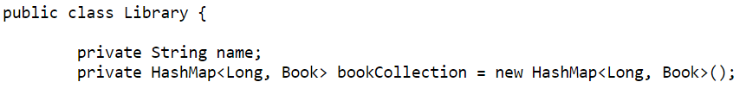


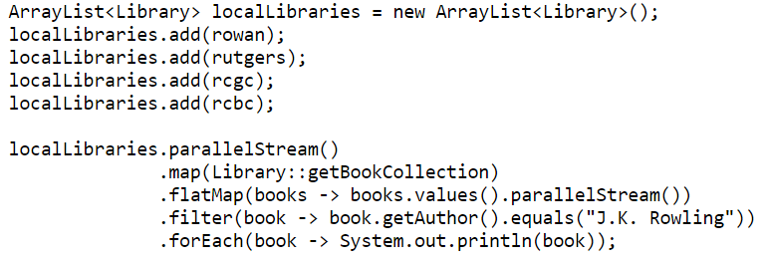
flatMap Turning a Collection into Individual Objects
z
…
…
40
41
42
43
44
46
47
48
49
50
51

Slide 18
Watching the stream
40
41
42
43
44
46
47
48
49
50
51
47: Library objects in stream
48: HashMaps<Long, Book> in stream
flatMap() returns a stream consisting of the results of replacing each element of this stream with the contents of a mapped stream
49: Book objects from the HashMaps in stream
filter
50: J.K. Rowling Books in stream

Slide 19
Reductions

Slide 20
Reductions
private static double averageSalaryByGender(
Set<Person> persons, Person.Gender gender) {
return persons.parallelStream()
.filter(p -> p.getGender() == gender)
.mapToDouble(Person::getSalary)
.average()
.getAsDouble(); // Why do we need? See next slide
}
Person objects
filter
Persons of specified gender r
Tell the JVM to process the Set of persons in parallel.
Filter based on the Gender passed to the method.
Return a stream of Doubles (a DoubleStream), so we can perform calculations on the persons of the desired gender. Note how the instance method was identified
Calculate the average using the average() method of DoubleStream. (You could also calculate the sum(), min() or max(). )
getAsDouble() is a functional interface which is used as the assignment target of the lambda expression. It returns the value from the call to average()
Doubles (salaries)
the average salary

Slide 21
Optionals
private static double averageSalaryByGender(
Set<Person> persons, Person.Gender gender) {
return persons.parallelStream()
.filter(p -> p.getGender() == gender)
.mapToDouble(Person::getSalary)
.average()
.getAsDouble();
}
Why do we need getAsDouble?
The average operation calculates the average value of the elements contained in the DoubleStream but returns an object of type OptionalDouble.
The OptionalDouble object may be an empty instance, or it might have the double answer you expect.
Hence we need .getAsDouble() to return the value. getAsDouble() will throw an exception if the OptionalDouble object is an empty instance.

Slide 22
Examining the Stream and more

Slide 23
Even more methods of the Stream class
boolean | allMatch(Predicate<? super T> predicate) The mutable reduction operation is called collect(), as it collects together the desired results into a result container such as a Collection. A collect operation requires three functions: a supplier function to construct new instances of the result container, an accumulator function to incorporate an input element into a result container, and a combining function to merge the contents of one result container into another.
boolean | anyMatch(Predicate<? super T> predicate) Returns whether any elements of this stream match the provided predicate.
Optional<T> | findAny() Returns an Optional describing some element of the stream, or an empty Optional if the stream is empty. Optionals are container objects which may or may not contain a non-null value. If a value is present, isPresent() will return true and get() will return the value.
Optional<T> | findFirst() Returns an Optional describing the first element of this stream, or an empty Optional if the stream is empty.

Slide 24
Check collections for conditions
private static List<Integer> luckyNumbers =
Arrays.asList(7, 10, 11, 19, 30, 41);
private static void matchTest() {
List<Integer> numsToTest = Arrays.asList( 7, 13 );
numsToTest.forEach(num ->
System.out.println(("Is " + num + " lucky? " +
luckyNumbers.stream()
.anyMatch(i -> i == num)))
);
numsToTest = Arrays.asList( 20, 100 );
numsToTest.forEach(num ->
System.out.println(("Are all lucky numbers < " + num + "? " +
luckyNumbers.stream()
.allMatch(i -> i < num)))
);
}
Is 7 lucky? true
Is 13 lucky? false
Are all lucky numbers < 20? false
Are all lucky numbers < 100? true

Slide 25
Another Example
private static boolean any (Collection<Person> coll, Predicate<Person> pred) {
return coll.stream().anyMatch(pred);
}
Predicate<Person> katy = person -> person.getFirstName().equalsIgnoreCase("katy");
System.out.println("Any Katy's? ==> " + any(persons, katy));
Predicate<Person> hugo =
person -> person.getFirstName().equalsIgnoreCase("hugo");
System.out.println("Any Hugo's? ==> " + any(persons, hugo));
The any method up top can work with any collection of Persons for any lambda function
Any Katy's? ==> true
Any Hugo's? ==> false

Slide 26
More Examples findFirst() and findAny()
private static Person findAnyTest() {
return persons.parallelStream()
.filter(p -> p.getEmail().contains(".com"))
.findAny()
.get();
}
private static Person findFirstTest() {
return persons.parallelStream()
.filter(p -> p.getEmail().contains(".com"))
.findFirst()
.get();
}
findFirst(). If you are not interested in getting a specific element, this gives the implementing stream more flexibility in case it is a parallel stream.
Any .com address ==> William S. Frawley
First .com address ==> Betty Rubble
// findAny is more flexible when processing a collection in parallel processes
System.out.println("Any .com address ==> " + findAnyTest());
System.out.println("First .com address ==> " + findFirstTest());

Slide 27
Other Stream Functions
limit(n)
The call stream.limit(n) returns a new stream that ends after n elements (or when the original stream ends if it is shorter).
Stream<Double> randoms = Stream.generate(Math::random).limit(100);
skip(n)
Does the exact opposite. It discards the first n elements.
concat(stream1, stream2)
Concatenates two streams together
Stream.concat(names.stream(), chars.stream()) // Sequential order
Stream.concat(names.parallelStream(), chars.parallelStream()) // In order by the fastest (first) to stream.

Slide 28
Sorting and Distinct
Stream<T> | sorted() Returns a stream consisting of the elements of this stream, sorted according to natural order.
Stream<T> | sorted(Comparator<? super T> comparator) Returns a stream consisting of the elements of this stream, sorted according to the provided Comparator
Stream<T> | distinct() Returns a stream consisting of the distinct elements (according to Object.equals(Object)) of this stream.

Slide 29
Sorting with Comparators (1)
private static void sortTest() {
System.out.println("\nThe original order of the Set");
persons.forEach(p -> System.out.println("\t" + p));
// Create comparators using lambda expressions
Comparator<Person> byAgeDescending =
(person1, person2) -> person2.getAge() - person1.getAge();
Comparator<Person> byAgeAscending =
(person1, person2) -> person1.getAge() - person2.getAge();
/* For these comparators, rely on the natural orders of
* String comparisons (i.e., alphabetically) and
* enum comparisons (i.e., order values from 1st to last)
*/
Comparator<Person> byLastName =
(person1, person2) ->
person1.getLastName().compareTo(person2.getLastName());
Comparator<Person> byGender =
(person1, person2) ->
person1.getGender().compareTo(person2.getGender());
// CONTINUED ON NEXT SLIDE

Slide 30
Sorting with Comparators (2)
private static void sortTest() {
// ...
// Now use the Comparators in the collection's stream
System.out.println("\nOldest to Youngest");
persons.stream()
.sorted(byAgeDescending)
.forEach(p -> System.out.println("\t" + p));
System.out.println("\nYoungest to Oldest");
persons.stream()
.sorted(byAgeAscending)
.forEach(p -> System.out.println("\t" + p));
System.out.println("\nAlphabetically by last name");
persons.stream()
.sorted(byLastName)
.forEach(p -> System.out.println("\t" + p));
System.out.println("\nBy Gender, then Alphabetically by last name");
persons.stream()
.sorted(byGender.thenComparing(byLastName))
.forEach(p -> System.out.println("\t" + p));
}
You can add .reversed() here to reverse the order the Comparator is enforcing.

